Slide 1

Inheritance
S1-2024-25, Object-Oriented Programming, Week 4

Slide 2
Objectives
Revise the last lab and discuss the most common pitfalls
Understand what UML (Unified Modelling Language) is and its role in software engineering.
Identify the basic components of UML, including diagrams, notations, and relationships.
Comprehend the concept of inheritance and its role in code reuse and hierarchy.
Apply method overriding to customize and extend base class methods.
Understand best practices, common pitfalls, and key takeaways related to inheritance and method overriding in OOP

Slide 3
Revision

Slide 4
Lab Questions
Q1: What is the primary purpose of using encapsulation in object-oriented programming? A: To protect attributes from being accessed externally.
Q2: What is the correct way to access the first element of a Python list my_list? A: my_list[0]
Q3: What does the @property decorator do in the context of the lab code? A: It defines a getter method for an attribute.
Q4: Which method is used to add an element to the end of a Python list? A: append()
Notes:
We did decorator usage in the tutorial! The tutorial is uploaded to brightspace. I noticed low attendance for the tutorial slot.

Slide 5
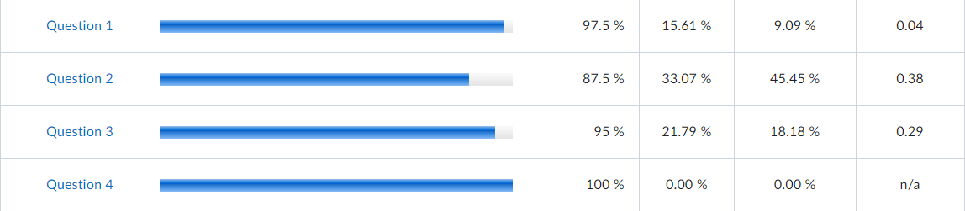
Lab Overview
Class Average: 89.2%
Notes:
Question 3 on decorators….the tutorial showed all the code. Lack of attendance in the tutorial.

Slide 6
The Code: Common Shortcomings
Reading instructions.
Defined classes aren’t used.
Lack of comments and documentation.
Lack of coherency.

Slide 7
Announcement
From this week, attendance in lab is mandatory. Without attendance the submission in the Brightspace will not be evaluated.

Slide 8
Why a Python Class Isn't Run Without Instantiating It and Calling Its Methods:
Python Class as a Blueprint: A Python class is like a blueprint or a plan for creating objects. It defines the structure and behaviour of objects, similar to how a recipe defines a dish but doesn't make it until you follow the steps.
Class as a Definition: When you define a class, you're essentially creating a definition or a description of what the objects based on that class will look like and what they can do.
Needs an Instance: Just defining a class doesn't create an actual object in memory. It's like having a recipe without cooking. To make use of the class, you need to create an instance (an actual object) from that class.

Slide 9
Cont’d
Instance Runs Methods: Once you have an instance of the class, you can call the methods defined within the class on that instance. This is when the actual "work" or "execution" happens. It's like following the recipe steps to cook a dish after having all the ingredients and instructions.
Separation of Definition and Execution: Python keeps the class definition separate from the execution for a good reason. It allows you to create multiple objects (instances) based on the same class, and each object can operate independently. It's like making multiple dishes from the same recipe – you can serve different plates, but the recipe remains the same.
Control and Reusability: This separation provides better control over your code and promotes reusability. You can define a class once and create as many instances as you need, ensuring consistency and efficiency in your code.
Only When Needed: Python is designed to be efficient, and it doesn't execute code unless explicitly instructed to do so. Defining a class doesn't automatically run the methods; Python waits until you create instances and call those methods.

Slide 10
Why Code Indentation Is Important in Python:
Readability and Structure: Indentation in Python is essential for making your code readable and structured. It acts like the formatting in a book, where paragraphs and sentences are properly spaced and organized.
Blocks of Code: Python uses indentation to define blocks of code. For example, a function or a loop is a block of code. Indentation indicates the beginning and end of these blocks, making it clear which lines of code are part of that block.
Consistency: Proper indentation ensures that your code follows a consistent structure. All blocks start with the same level of indentation and maintain the same pattern throughout the code, which helps you and others understand the logic.

Slide 11
Cont’d
Error Prevention: Incorrect indentation can lead to syntax errors. Python relies on proper indentation to understand the structure of your code. If your indentation is inconsistent or incorrect, it may result in unexpected errors.
Human-Friendly: Python is known for its readability, and clear indentation is a big part of this. It's almost like writing a story; proper indentation helps others understand your code as if they're reading a well-organized book.
Pythonic Style: The Python community follows specific style guidelines, and proper code indentation is one of them. Writing code with consistent indentation is considered a Pythonic style, making your code more in line with the conventions used in the Python world.
Enhanced Debugging: When you encounter issues in your code, the consistent structure provided by indentation makes it easier to identify problems and debug your code. It's like having a map that guides you to the issue's location.

Slide 12
Why Writing a Good Code Header Is Important:
Documentation: A code header serves as documentation for your code. It's like the title and summary of a book; it provides essential information about what the code does, who wrote it, and how to use it.
Clarity: A well-crafted code header makes your code more understandable. Just like a book's title gives you a clear idea of its content, a code header helps readers (including yourself) quickly grasp the purpose and functionality of your code.
Context: Think of the code header as the blurb on the back of a book. It sets the context and expectations for the code. It answers questions like "What problem does this code solve?" and "How does it do that?".

Slide 13
Cont’d
Attribution: Like the author's name on a book's cover, the code header attributes the author(s) of the code. It provides transparency and credit for the work.
Usage Instructions: A code header often includes usage instructions and examples. It tells users how to interact with the code, which is like a user manual for the book.
Error Prevention: Clear and informative code headers help prevent misunderstandings and misuse of the code. Just as a clear book title avoids confusion, a good code header reduces the chances of errors.
Consistency: Following a standardized format for code headers (like the conventions in a book) ensures that every piece of code in a project is presented in a similar, recognizable manner.

Slide 14
Cont’d
Searchability: When you have a collection of code, well-structured headers make it easier to find the specific code you're looking for. It's like having an index or table of contents in a book.
Compliance: In some cases, industries or organizations require specific information in code headers to comply with legal or ethical standards. A good code header ensures you meet these requirements.
Community and Collaboration: In open-source projects or collaborative coding environments, clear code headers help other developers understand, use, and contribute to your code, similar to how well-documented books can be understood by a wider audience.

Slide 15
Why Writing Good Inline Code Comments Is Important:
Clarity: Inline code comments are like side notes in a book's margins. They provide explanations within your code, helping readers (including yourself) understand complex or non-intuitive sections of code.
Documentation: Just as footnotes in a book provide additional information, inline comments document the code's purpose, logic, and any known issues. They make the code more approachable and usable.
Debugging and Troubleshooting: Code comments can serve as a trail of breadcrumbs, guiding you or other developers during debugging and troubleshooting. They highlight potential issues, solutions, and areas of interest.

Slide 16
Cont’d
Change History: Like a book's edition history, comments can record changes made to the code over time. They document why changes were made, when, and by whom, which is invaluable for tracking code evolution.
Collaboration: Inline comments enable easier collaboration. When multiple people work on a project, clear comments help team members understand each other's code, fostering a collaborative atmosphere.
Self-Explanation: A well-commented code section is like a self-explanatory chapter in a book. It reduces the need for extensive external documentation by encapsulating explanations within the code.

Slide 17
Cont’d
Customization: Comments can provide options for customization, similar to a book with multiple endings or alternate storylines. They allow users to adapt the code to their specific needs by explaining where changes can be made.
Legibility: Well-formatted code comments improve code legibility. Just as a well-structured book with headings and subheadings is easier to read, comments organize and clarify the code's structure and logic.
Reminders: Code comments act as reminders, prompting you to revisit or improve certain parts of the code. They function like sticky notes, marking areas for future attention.
Education and Onboarding: Inline comments help newcomers learn the codebase, like a glossary explaining terminology in a book. They reduce the learning curve and improve onboarding for new developers.
Regulatory Compliance: In regulated industries or open-source projects, inline comments can be crucial for compliance. They document steps taken to ensure adherence to standards and best practices.

Slide 18
UML

Slide 19
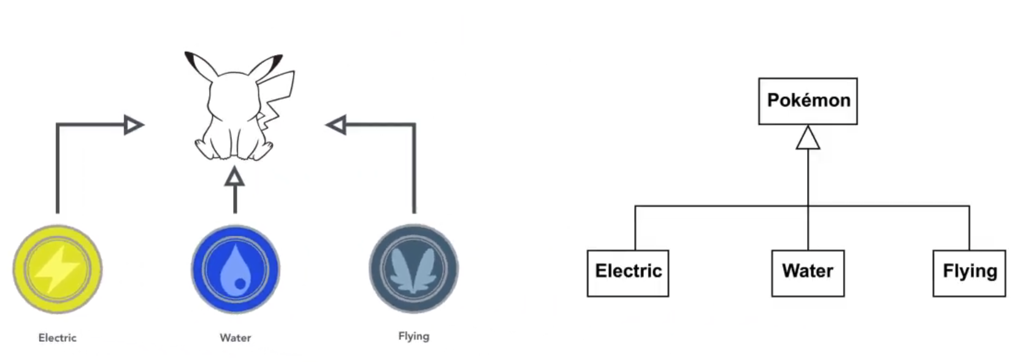
Motivation
Understanding a software system but just looking at its very source code can be very time-consuming.
Communicating ideas about software design.

Slide 20
Unified Modelling Language (UML)
Unified Modelling Language (UML) is like a special design language.
It helps people draw pictures and write notes about how they want to create something, like computer software.
UML is a bit like making a map for building something, so everyone involved understands how it should work.
It simplifies complex ideas, making it easier to design and build things like software programs.
UML helps with organizing thoughts and collaborating with others in the design process.

Slide 21
Purpose of UML
UML, or Unified Modelling Language, is a visual language used for designing and documenting complex systems.
It provides a standard way to visualize the design of a system, making it easier to understand and communicate.
UML helps in the development of software, as well as other systems like databases and hardware.
It is a tool for planning, communicating, and documenting different aspects of a system.

Slide 22
How UML Helps in OOP
UML is particularly useful in Object-Oriented Programming (OOP) as it helps in designing classes and their relationships.
It allows developers to create visual representations of software systems using diagrams like class diagrams, which show the structure of the classes and their interactions.
UML diagrams facilitate better planning, making it easier to identify and solve design issues early in the development process.
UML is not just about drawing pictures; it also provides a common language for developers and stakeholders to discuss and understand the system's design and behaviour.
Using UML in OOP enhances the clarity and maintainability of the software, leading to more efficient and error-free development.

Slide 23
Basic UML Concepts
These components are used to create visual representations of a system, making it easier to design, understand, and communicate complex systems in a standardized manner.
Class Diagrams: These represent the structure of the system by illustrating classes, attributes, operations, and their relationships.
Object Diagrams: These depict instances of classes and their relationships, showing specific data at a point in time.
Use Case Diagrams: They describe the interactions between a system and external entities, focusing on what the system does from a user's perspective.
Sequence Diagrams: These illustrate how objects interact over time, showcasing the order of messages between objects.
Activity Diagrams: They describe workflows, business processes, and the flow of control among activities.
Many more: State Machine Diagrams, Component Diagrams, Deployment Diagrams, Package Diagrams, Collaboration Diagrams, Composite Structure Diagrams, Profile Diagrams, Timing Diagrams, Communication Diagrams.

Slide 24
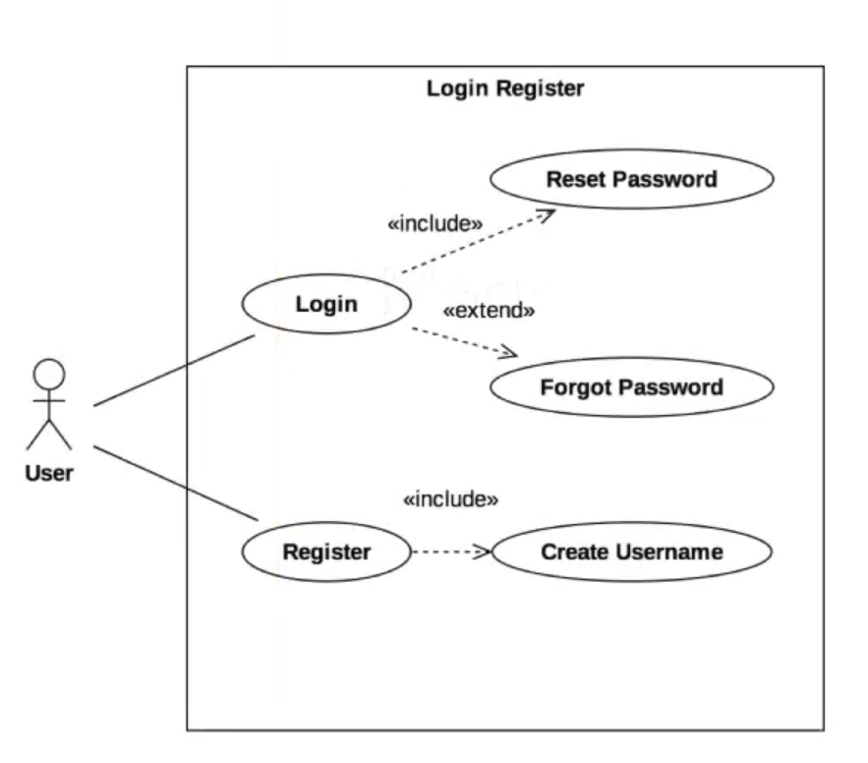
UML diagram types
Use-case diagrams:
Functional model of the system from user’s point of view.

Slide 25
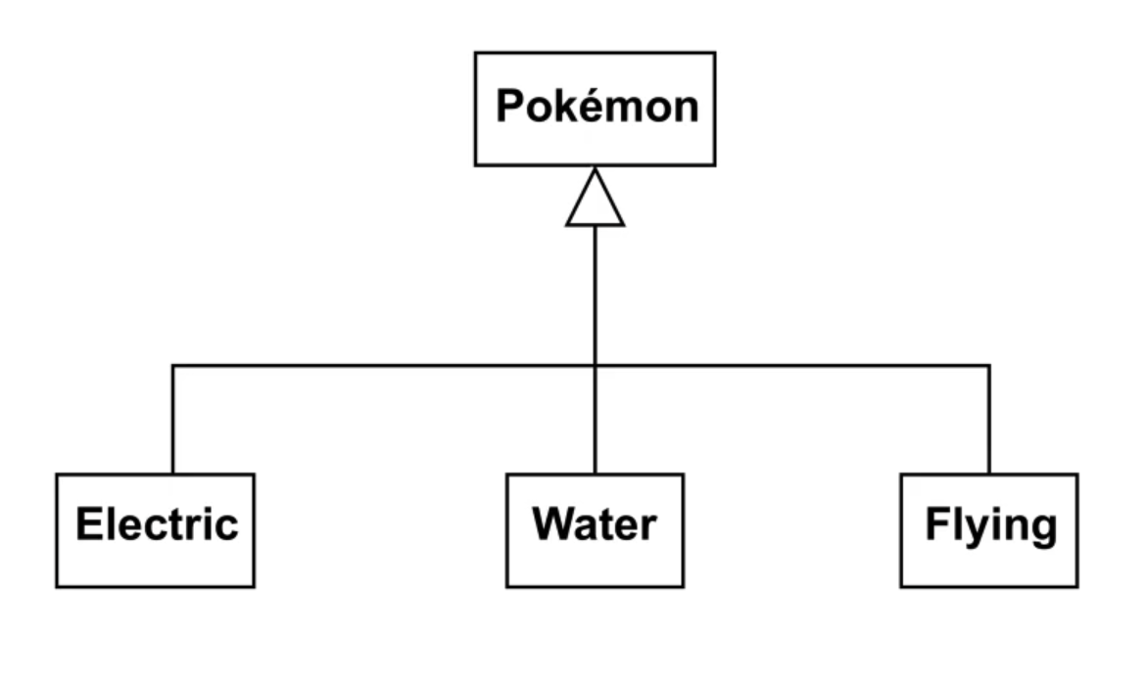
UML diagram types
Structural diagram
To describe structure of the program
Class diagram

Slide 26
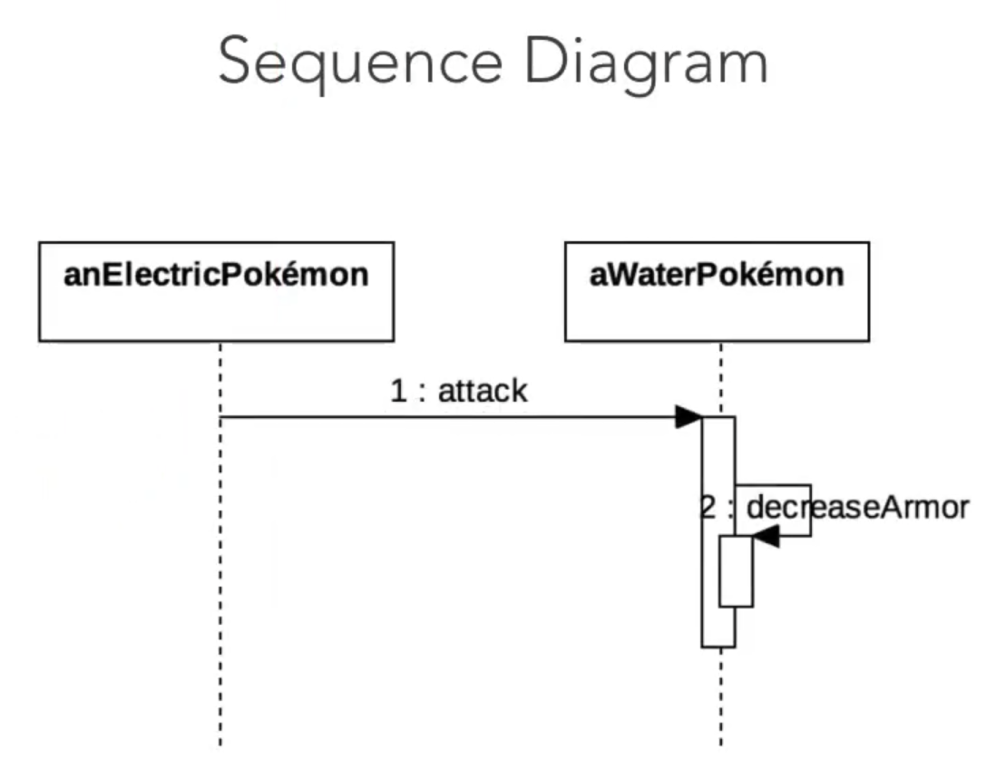
UML diagram types
Dynamic behavior
Behavior of diagram describes the functionality of the systems like its sequence.

Slide 27
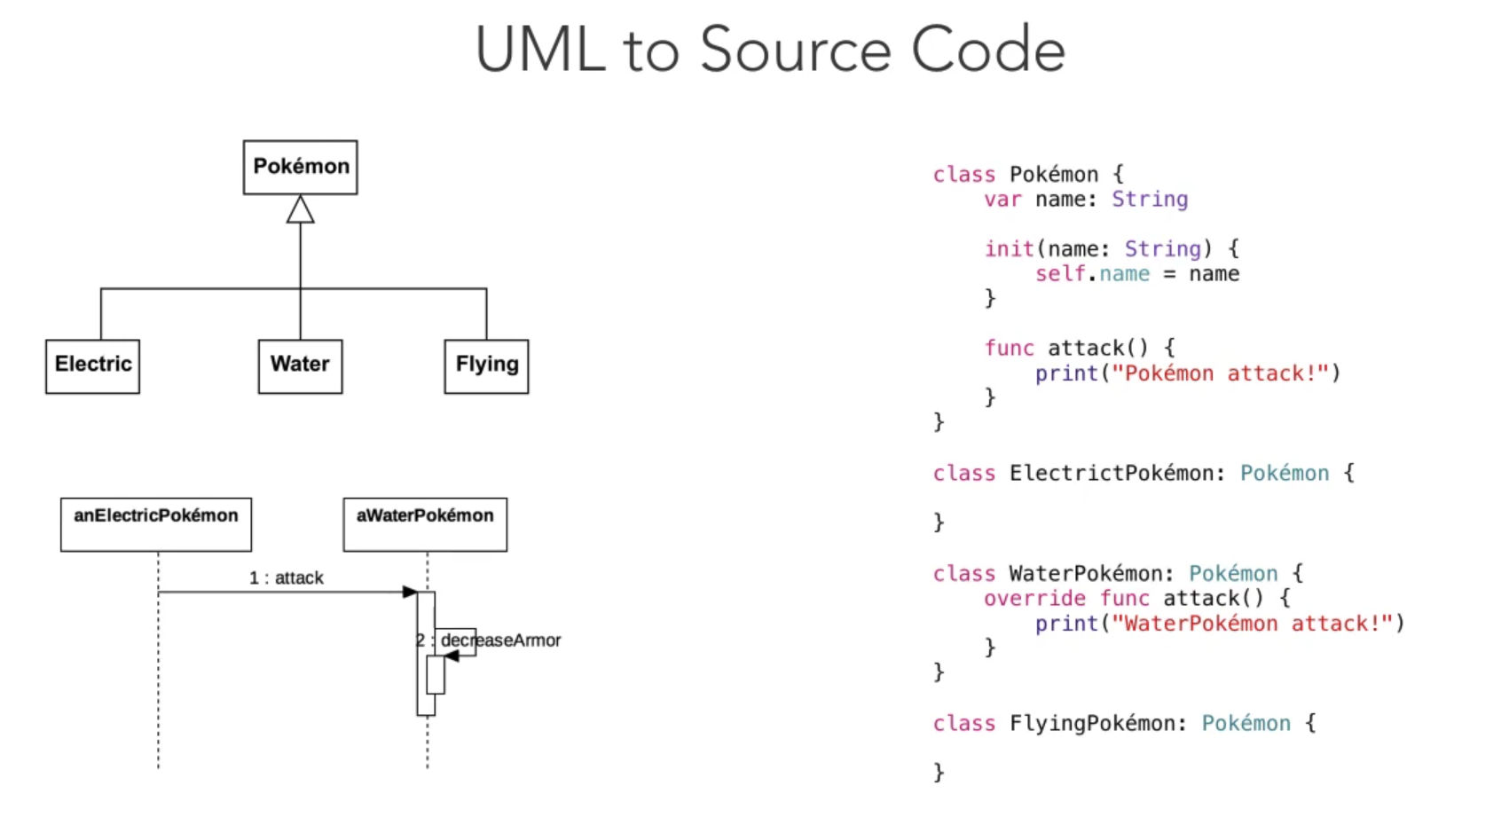
UML use-case

Slide 28
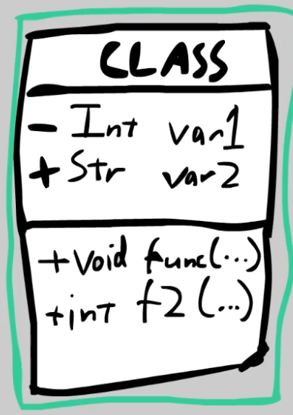
Boxes: Classes
Name at Top
Then Variables of class, and finally Functions
“+” = Public, “-” = Private
Follow +/- with data type

Slide 29
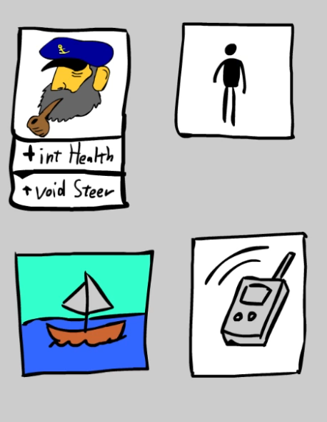
Example
Create a Captain, Human, SailBoat, and Radio classes.
Give the Captain a “health” var
Also, a “steer()” function

Slide 30
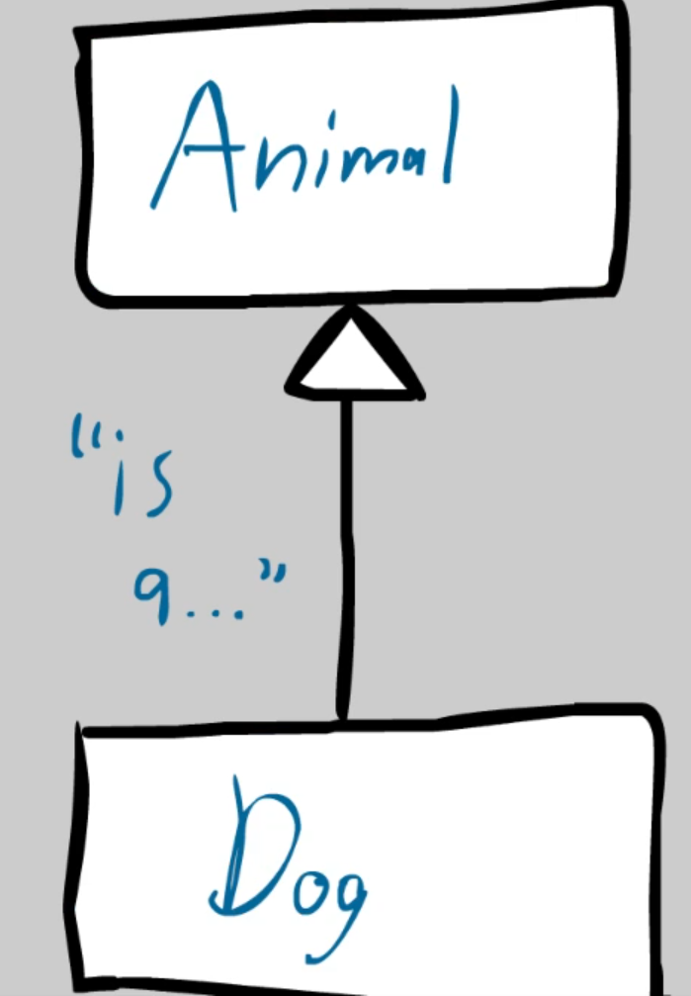
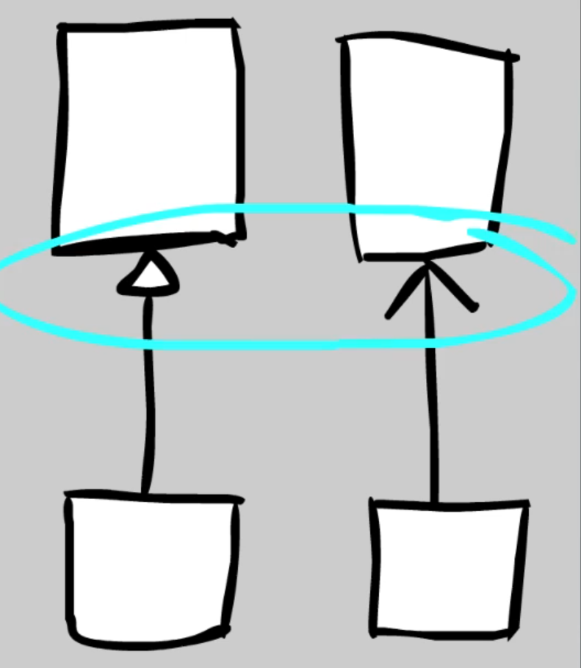
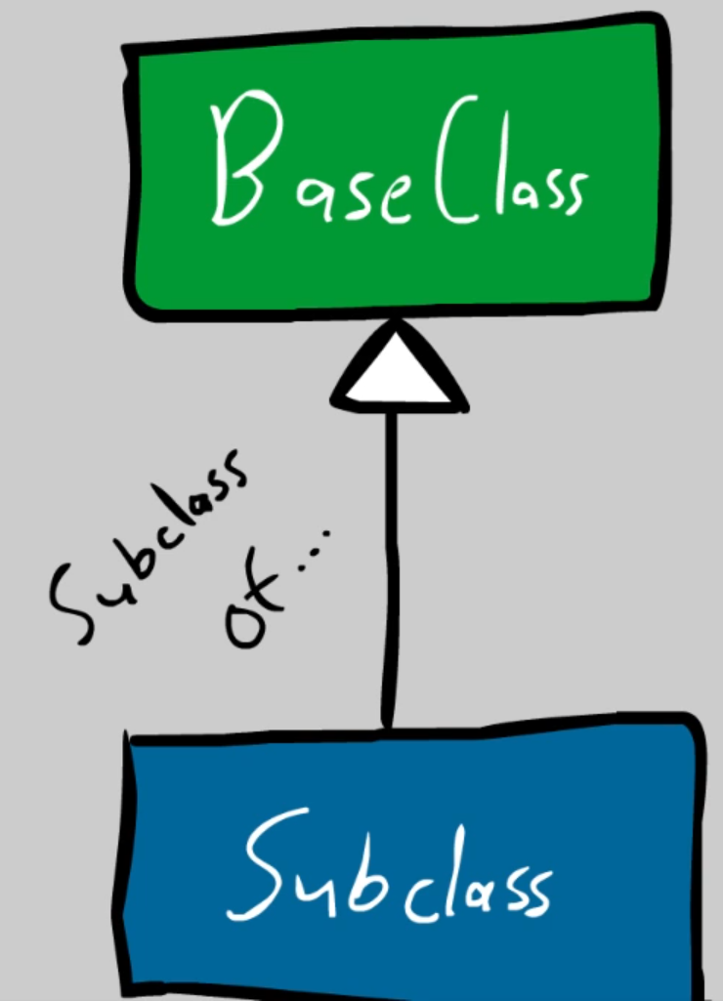
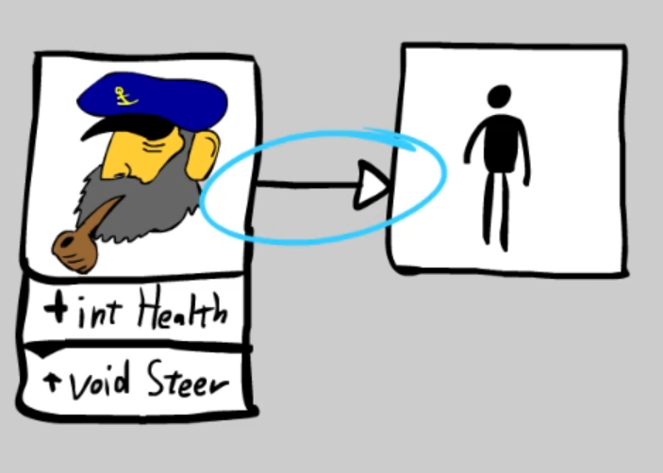
Example
Connections: Arrows
Hollow Arrow = “Subclass of” or “is a”
Examples:
Circle is a shape
Dog is an Animal
Car is a Vehicle
Captain is a Human

Slide 31
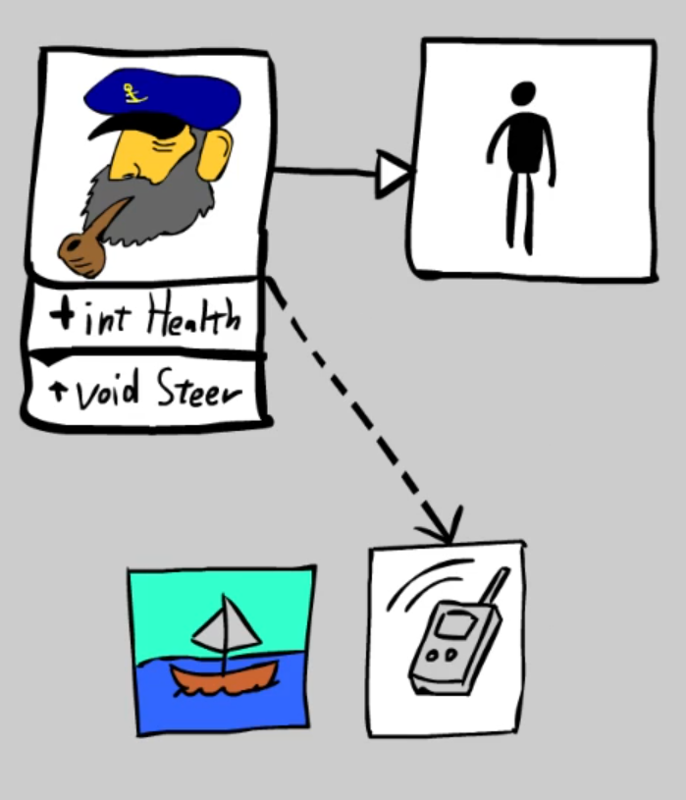
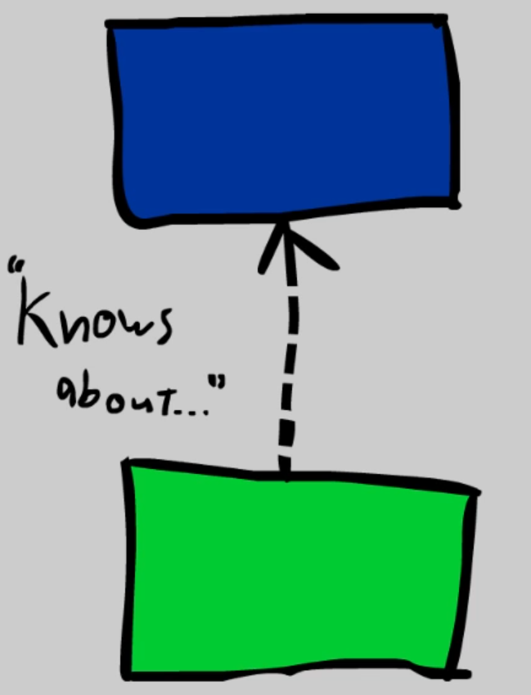
Example
Spikey/Open Arrow = “knows about” or “communicates with”
For non-inheriting relationships
Often, line is dashed
Should have descriptive text

Slide 32
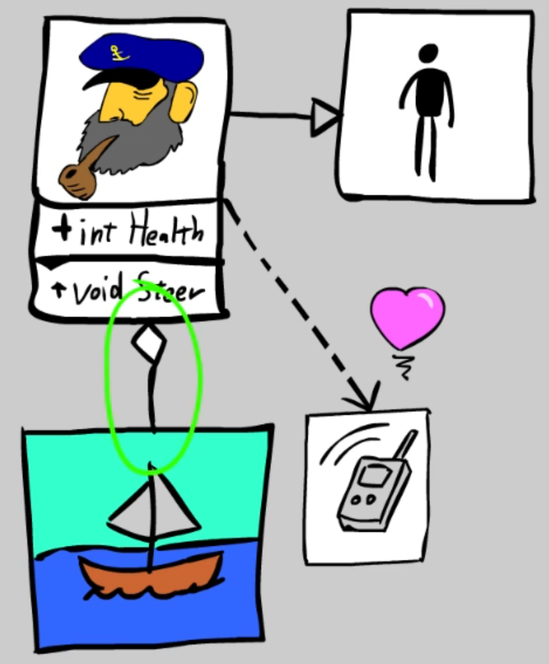
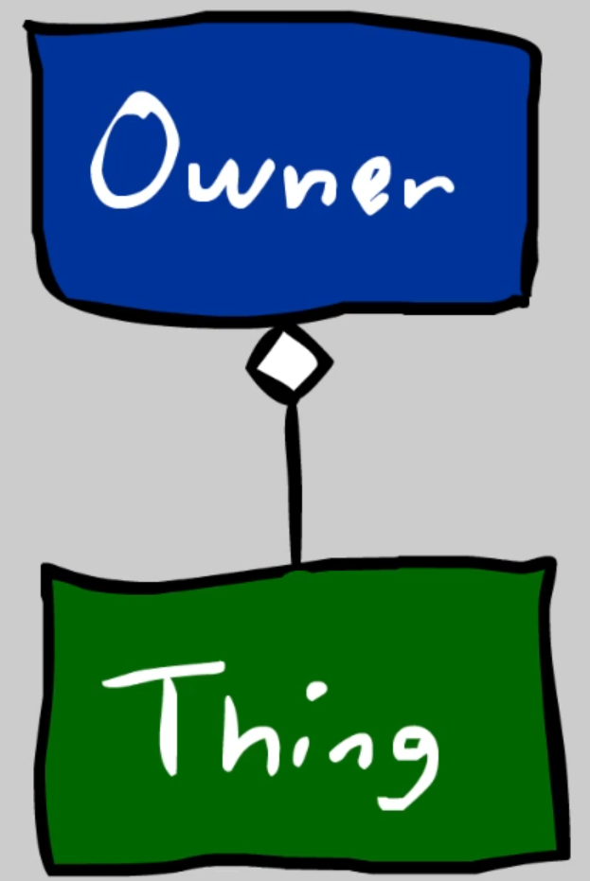
Example
Diamond touches the “Owner” of “Thing”
Two different types: Solid and hollow
Example: Captain OWNS Ship

Slide 33
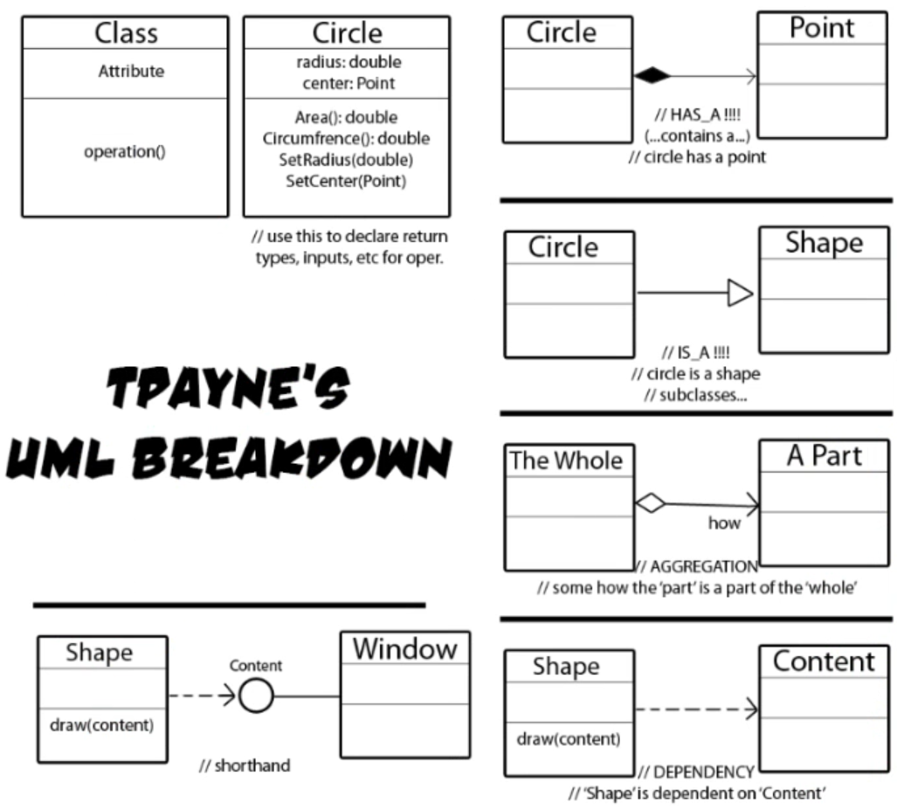
Overview

Slide 34
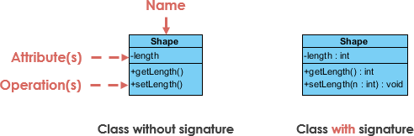
Class Diagram Example
[1]

Slide 35
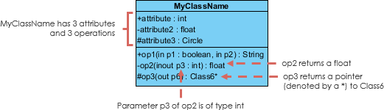
Methods in UML Class Diagrams
[1]

Slide 36
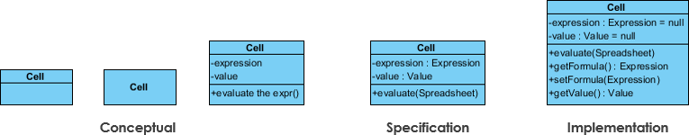
Different Levels of Class Diagrams
[1]

Slide 37
The Class Diagram
Classes: The primary elements within a class diagram are the classes themselves, which represent objects or concepts in the system. Each class is depicted as a rectangle with three compartments: the top one contains the class's name, the middle lists its attributes, and the bottom part displays its methods.
Attributes: Attributes are characteristics or properties associated with a class. These are represented in the middle compartment of the class rectangle. They provide information about the class's state or data.
Methods: Methods are the operations or functions that a class can perform. They are also listed in the middle compartment of the class rectangle. Methods represent the behaviour or functionality of the class.
Relationships: Class diagrams show how classes relate to one another through various types of relationships. Common relationships include associations (lines connecting classes), aggregations (a form of association that indicates a whole-part relationship), generalization (inheritance), and dependencies. These relationships define how objects interact within the system.

Slide 38
The Class Diagram Cont’d
Multiplicity: Multiplicity notations are used to specify how many instances of one class are related to another class in an association. For instance, a "1" next to the line connecting two classes signifies a one-to-one relationship, while "0..*" indicates that there can be zero or more instances.
Visibility: Visibility modifiers, such as public (+), private (-), and protected (#), are placed in front of attributes and methods to indicate their accessibility. Public attributes and methods are denoted with a "+," private with a "-", and protected with a "#."
Inheritance and Generalization: Inheritance relationships are displayed with solid lines that connect a subclass to a superclass. This represents the concept of a subclass inheriting attributes and methods from a superclass. In UML, it's shown as an arrow pointing from the subclass to the superclass.
Abstract Classes: Abstract classes are depicted in italics or with the name inside curly braces. They represent classes that cannot be instantiated and serve as templates for subclasses.

Slide 39
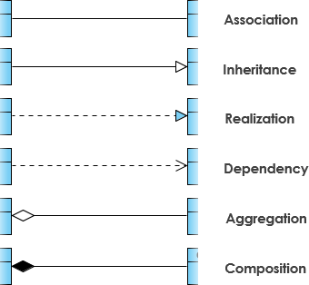
Relationships Overview
[1]
Notes:
Interesting to us are Association, Inheritance, Aggregation and Composition.

Slide 40
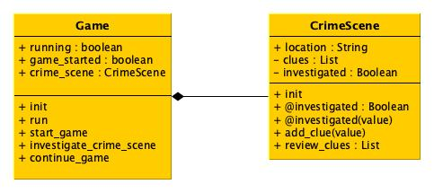
Example Instead of a Word Description of Our Lab
In class models, you can skip the noise of boilerplate signatures for standard setters and getters.
UML doesn't provide a standard notation for representing getters and setters for private attributes.
Create your own convention to indicate getters and setters for private attributes. As I have done in this example.
Represent the convention using a UML Comment, which looks like a rectangle with the upper right corner bent (also known as a "note symbol") attached to the diagram.

Slide 41
True or False?
UML diagrams are primarily used for writing and executing Python code.

Slide 42
Inheritance

Slide 43
What is Inheritance?
Inheritance allows you to build new things based on existing things, just like building new LEGO creations using pieces from an existing set.
Inheritance in Object-Oriented Programming (OOP) is like passing down traits from parents to children:
Parent-Child Relationship: Think of it as a parent class (like a blueprint) giving its characteristics to a child class (a more specific version).
Reusing Code: It's a way to avoid repeating code. The child class inherits properties and behaviours from the parent class.
Specialization: The child class can add its unique features while keeping the common ones from the parent.
Hierarchy: Classes can form a hierarchy, with each child class inheriting from a parent class.
Saves Time: Inheritance saves time and effort because you can use existing, tested code.
Easy Updates: If you update the parent class, all the child classes get the improvements too.
Example: If you have a "Vehicle" parent class, a "Car" child class can inherit features like "wheels," "engine," and "steering."

Slide 44
Basic Inheritance Example
class Vehicle: def describe(self): return "This is a vehicle." class Car(Vehicle): def __init__(self, brand): self.brand = brand car = Car("Toyota") print(car.describe())
When a class inherits from another class, you can create instances of the subclass without needing to create instances of the base class.
In the example with a Car and Vehicle class, a Car is a specific type of Vehicle, so it inherits the attributes and methods of the Vehicle class.
You can create a Car instance directly without first creating a Vehicle instance because a Car is a standalone entity, even though it inherits properties from a Vehicle.
This approach adheres to the "is-a" relationship in inheritance: a Car is a Vehicle, but you don't need to create a generic Vehicle instance before creating a specific Car instance.
Notes:
Output: This is a vehicle.

Slide 45
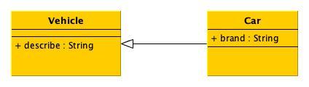
Inheritance in UML

Slide 46
Another Inheritance Example
Inheritance models an is-a relationship: Student is a Person.
Student inherits from Person.
What do they inherit?
Methods
Attributes

Slide 47
Benefits of Inheritance
Inheritance simplifies code, makes it more maintainable, and facilitates the creation of efficient class hierarchies.
Code Reusability: Inheritance enables you to reuse code from a parent class, saving time and effort.
Organized Structure: It helps in organizing classes into hierarchies, making code more structured and understandable.
Customization: Child classes can extend and modify behaviours inherited from the parent class to suit their specific needs.
Maintenance Efficiency: When you update the parent class, changes are automatically inherited by child classes, reducing maintenance efforts.
Conceptual Clarity: It promotes the "is-a" relationship, making it clear that a child class is a specialized version of the parent class.
Simplification: By inheriting common attributes and methods, child classes can focus on their unique features.

Slide 48
Extending Classes Through Inheritance
Extending classes through inheritance provides a foundation for reusing and building upon existing code to create more specialized classes.
Inheriting Attributes and Methods: Child classes inherit attributes and methods from parent classes, establishing a base set of features.
Base or Parent Class: The class being inherited from is often referred to as the base or parent class.
Derived or Child Class: The class inheriting from another class is known as the derived or child class.
Access to Parent Class Features: Child classes can access and use all the attributes and methods of their parent class.
Creating a Hierarchy: Inheritance allows you to create a hierarchical structure of classes, enhancing code organization.
Specialization: Child classes can add additional attributes or methods to tailor the inherited behaviour to their specific needs.
Overriding Methods: Child classes can override inherited methods to provide their own implementations.

Slide 49
Customizing Methods
Customizing methods through overriding is a powerful way to tailor the behaviour of a child class to better match its specific requirements, promoting code reuse and adaptability.
Method Overriding: Method overriding allows a child class to provide its own implementation for a method that it inherits from the parent class.
Modifying Behaviour: By overriding methods, you can modify the behaviour of a parent class method to suit the needs of the child class.
Same Method Signature: To override a method, the child class method must have the same method name and parameters as the parent class method.
Flexibility and Reusability: Method overriding provides flexibility in adapting the behaviour of inherited methods while reusing their names.

Slide 50
Method Overriding in Python
Method overriding in Python involves redefining a method in a child class that's already defined in the parent class.
Syntax Example: To override a method, you use the same method name and parameters in the child class.
Method overriding in Python enhances the adaptability and flexibility of code, as it enables customization of inherited methods according to specific child class needs.
Polymorphism: Method overriding allows different child classes to have their unique behaviour for the same method name, contributing to polymorphism.

Slide 51
Example Code of Method Overriding
class Vehicle: def describe(self): return "This is a vehicle." class Car(Vehicle): def __init__(self, brand): self.brand = brand def describe(self): return f"This is a {self.brand}." car = Car("Toyota") print(car.describe())
Same method name.
Same method signature.
Different method logic.
Notes:
Output: This is a Toyota.

Slide 52
The super() Method
The super() method is a powerful tool for customizing the behaviour of inherited methods, allowing the child class to enhance or extend the functionality of the parent class while maintaining its core behaviour.
The Parent Class Relationship: In Python, the super() function is used to invoke a method from the parent class.
Access to Parent Class: By using super(), you can access and call a method of the parent class from within the child class.
Syntax Example: super().method_name() is the standard syntax for invoking a method from the parent class.
Passing Arguments: You can pass any number of arguments to the parent class method, similar to any other method call.

Slide 53
Example super() in Python
class Vehicle: def __init__(self): self.wheels = 4 def describe(self): return "This is a vehicle." class Car(Vehicle): def __init__(self, brand): super().__init__() self.brand = brand def describe(self): return f"This is a {self.brand} and has ”
f"{self.wheels} wheels."
Vehicle has a wheels instance variable.
We link to this using super() in the Car’s init method.
We can then access it via self.wheels anywhere inside Car.
Notes:
Output: This Toyota has 4 wheels.

Slide 54
Method Overriding Best Practices
Consistent Signature: When overriding a method, the new method in the derived class should have the same name, return type, and parameters as the parent class method.
Call Super Method: If the derived class wants to extend the behaviour of the parent class method, it should call the parent class method using super(). This allows you to add to, rather than replace, the original behaviour.
Avoid Changing Behaviour Drastically: While method overriding allows customization, it's essential to maintain a consistent interface and behaviour, ensuring derived classes adhere to the principles of the base class.
Document Overrides: Clearly document when a method is intentionally overridden. Describe the changes and the reason for the modification.
Test Thoroughly: Make sure to thoroughly test the overridden methods to ensure they function as expected, taking into account both the parent and child class's specific behaviours.

Slide 55
True or False?
Inheritance allows a class to inherit attributes and methods from another class, creating a parent-child relationship between the classes.

Slide 56
Access Modifier Protected
Limited Accessibility: Protected members are intended to be used within the class itself and its subclasses. They are not accessible from outside the class.
Conventional Protection: The protection level is a convention rather than a strict access control. The Python interpreter doesn't restrict access; it's up to the developer to respect this convention.
Single Underscore Prefix: A protected member is typically named with a single underscore prefix, such as _variable or _method.
Intended for Subclasses: The primary use of protected members is to provide a way for subclasses to access and manipulate inherited attributes and methods.
Code Organization: It helps to maintain the integrity and encapsulation of a class, indicating which parts are intended to be used and which should be treated as internal details.
Communication to Developers: It's a way to signal to other developers working with the class that these members are not part of the public interface and should be used with caution.

Slide 57
Python Example: Protected Access Modifier
Python Classes
Usage
class Vehicle: def __init__(self): self._wheels = 4 def describe(self): return "This is a vehicle." class Car(Vehicle): def __init__(self, brand): super().__init__() self.__brand = brand def describe(self): return f"This is a {self.__brand} and has “
f”{self._wheels} wheels."
car = Car("Toyota") print(car.describe())
Output
This is a Toyota and has 4 wheels.

Slide 58
Single Inheritance
Single Inheritance is a fundamental concept in object-oriented programming where a class inherits properties and methods from a single parent class.
Single inheritance is an essential OOP concept that forms the basis for building complex class hierarchies, enabling you to structure your code in a clear and straightforward way.
One Parent, One or many Children: In single inheritance, a child class inherits from just one parent class, creating a simple relationship.
Reusing Code: Single inheritance promotes code reuse by allowing the child class to inherit and reuse the attributes and methods of its parent.
Ease of Use: It simplifies the class hierarchy by making it easy to understand and manage, which can be especially helpful in small to medium-sized projects.

Slide 59
Method Resolution Order
The MRO plays a crucial role in determining the order in which base (super) classes are considered when an attribute or method is accessed from a derived (sub) class. It helps ensure that the base class methods are used correctly in an inheritance hierarchy.
class A: pass class B(A): pass
b = B() print(B.__mro__)
Output:
(<class '__main__.B'>, <class '__main__.A'>, <class 'object'>)

Slide 60
Python Object Class
Base Class: The object class serves as the base class for all classes, creating a hierarchy where all user-defined classes indirectly inherit from it. This hierarchy allows Python to manage objects uniformly.
Inheritance: All classes in Python implicitly inherit from the object class. You don't need to specify this inheritance explicitly; it's automatic. For example, class MyClass: implicitly inherits from object.
Attributes and Methods: The object class provides fundamental attributes and methods common to all objects in Python. These include __str__, __repr__, __eq__, __hash__, and more. These methods are essential for custom classes to work properly.
Default Implementations: object provides default implementations for methods like __str__ and __repr__, which, if not overridden in your custom classes, return basic string representations and memory addresses.
Method Overriding: You can override methods inherited from object to customize the behaviour of your own classes. For example, you might override the __str__ method to provide a custom string representation of objects.
No Direct Instances: You generally don't create instances of the object class directly. Instead, it's used as a building block for other classes and their objects.

Slide 61
Multiple Inheritance
Multiple inheritance can be a valuable tool in large and complex software systems but must be used with caution due to the increased complexity it introduces. It's essential for designing flexible and extensible class structures.
Multiple Inheritance is an advanced concept in object-oriented programming that allows a class to inherit properties and methods from more than one parent class.
One Child, Multiple Parents: In multiple inheritance, a child class inherits attributes and behaviours from two or more parent classes, creating complex class hierarchies.
Mixing Functionality: Multiple inheritance is particularly useful when you want to create a class that combines features from several different sources.
Challenges and Ambiguities: While powerful, multiple inheritance can introduce challenges related to method naming conflicts and code organization. Careful design is crucial to avoid ambiguity.

Slide 62
Polymorphism
Versatile Behaviour: Polymorphism in Python allows objects of different classes to be treated as objects of a common base class. This means that objects can be used interchangeably, even if they belong to different classes.
Method Overriding: It often involves method overriding, where a subclass provides a specific implementation of a method that's already defined in its base class. This allows different classes to have methods with the same name but different behaviours.
Dynamic Binding: The specific method called when using polymorphism depends on the actual object's class at runtime. This dynamic binding allows flexibility in method invocation.

Slide 63
Python Example
class Shape: def area(self): pass # Placeholder method class Circle(Shape): def __init__(self, radius): self.radius = radius def area(self): return 3.14 * self.radius * self.radius class Rectangle(Shape): def __init__(self, width, height): self.width = width self.height = height def area(self): return self.width * self.height
# Polymorphism in action shapes = [Circle(5), Rectangle(4, 6)] for shape in shapes: print(f"Area: {shape.area()}") # Calls the appropriate area method
Output:
Area: 78.5
Area: 24

Slide 64
Polymorphism and Inheritance
Inheritance and polymorphism work hand in hand, facilitating code organization, reusability, and adaptability in object-oriented programming. Understanding these concepts is fundamental to building flexible and maintainable software systems.
Polymorphism is a fundamental concept in object-oriented programming that plays a crucial role in inheritance. It allows objects of different classes in an inheritance hierarchy to be treated as objects of a common base class.
Realizing Polymorphism: Through inheritance, you can create a hierarchy of classes where child classes can be substituted for their parent classes, providing a level of abstraction that simplifies the handling of objects.
Polymorphism and Method Overriding: Method overriding enables the implementation of polymorphism. When a child class overrides a method from its parent class, you can invoke the overridden method using a reference to the parent class, but the overridden version will execute.
Dynamic Binding: Polymorphism allows for dynamic method binding, meaning the appropriate method to be executed is determined at runtime based on the actual class of the object.
Benefits of Polymorphism: Polymorphism enhances code flexibility and reusability, making it easier to work with complex class hierarchies. It simplifies interaction with objects by providing a consistent interface.

Slide 65
Class Hierarchies Overview
Inheritance leads to the creation of class hierarchies, a way to structure and organize related classes.
Base or Parent Class: The top-level class in a hierarchy is often called the "base" or "parent" class. It contains common attributes and methods shared by all the derived classes.
Derived or Child Classes: Below the parent class are the "derived" or "child" classes. These classes inherit attributes and behaviours from the parent class and can add new attributes or methods specific to their needs.
Specialization: Each derived class represents a specialization of the parent class. It adds its unique features while inheriting and reusing those of the parent class.
Code Reusability: Class hierarchies enhance code reusability, reducing redundancy and making it easier to manage and maintain software systems.
Example: In a zoo management system, you might have an Animal base class with common properties like name, age, and species. Derived classes like Lion, Tiger, and Bear inherit from Animal and add specific features.

Slide 66
Key Takeaways
Inheritance is a fundamental concept in object-oriented programming (OOP) that allows a new class to inherit properties and behaviours from an existing class.
In Python, inheritance is achieved by creating a new class that derives from an existing class, referred to as the base or parent class.
The derived class (subclass) can extend, modify, or customize the attributes and methods inherited from the base class.
Method overriding enables a subclass to provide its own implementation for a method defined in the parent class, allowing for polymorphic behaviour.
The super() function is used to call the overridden method from the parent class within the overriding method.
Single inheritance is when a class inherits from only one base class, while multiple inheritance allows a class to inherit from more than one base class.
Proper design and adherence to best practices are essential for creating maintainable class hierarchies and avoiding common pitfalls.

Slide 67
References
UML Examples, Visual Paradigm, https://www.visual-paradigm.com/guide/uml-unified-modeling-language/uml-class-diagram-tutorial/, accessed Oct 2023.

Slide 68
Contact Me
Via E-Mail
SunderAli.Khowaja@tudublin.ie
Or contact the School Office:
school.cs@tudublin.ie

